Slide 1

MIGRATION
LOGO DE LA CONSULTORA
A PROJECT ABOUT HOW MOVING PEOPLE INFLUENCE COUNTRIES.

Slide 2
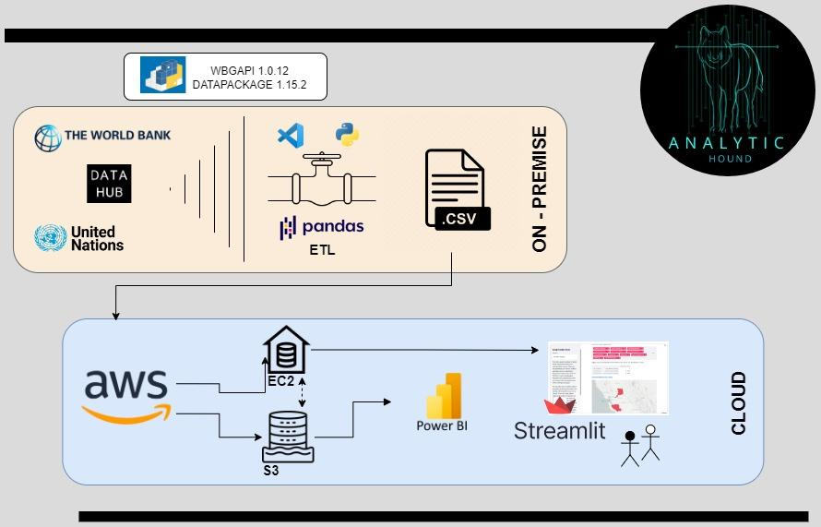
WORKFLOW

Slide 3



SOURCES
For the project we decided to do it without the data provided because we found data of higher quality, variety, temporal frequency and better availability.

Slide 4
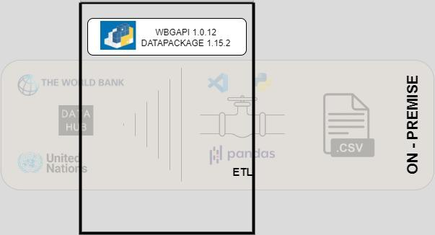
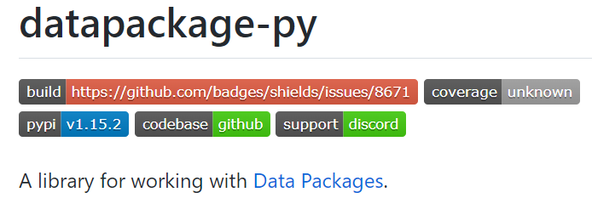
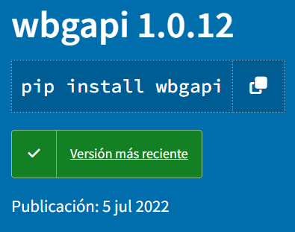
INCREMENTAL DATA LOAD

Slide 5
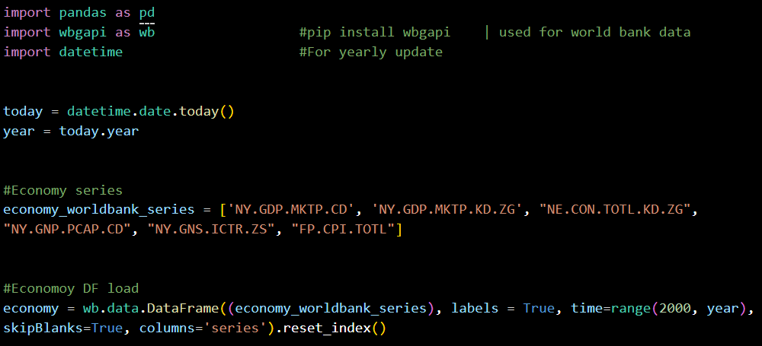
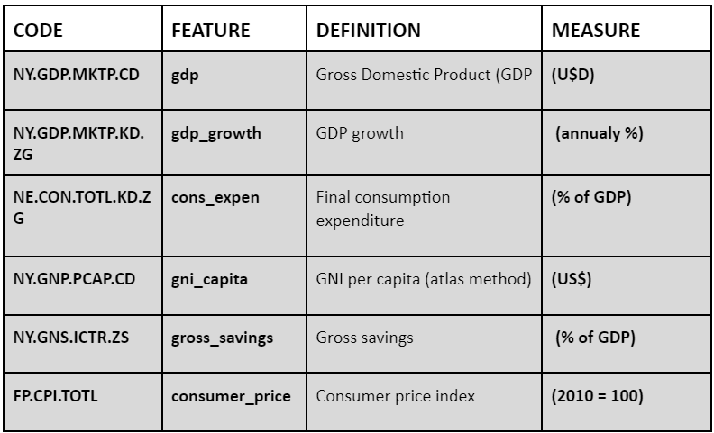
INCREMENTAL DATA LOAD

Slide 6
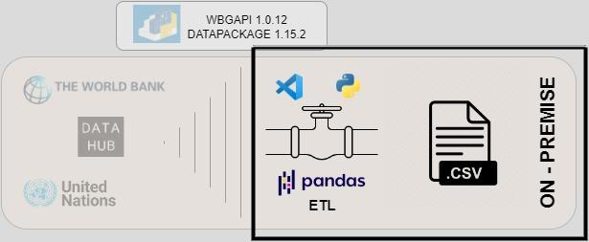
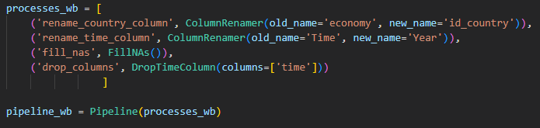
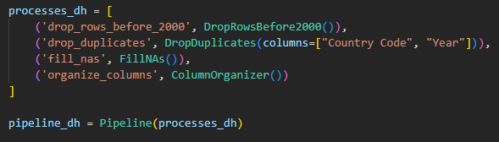
ETL & PIPELINE

Slide 7

STACK

Slide 8
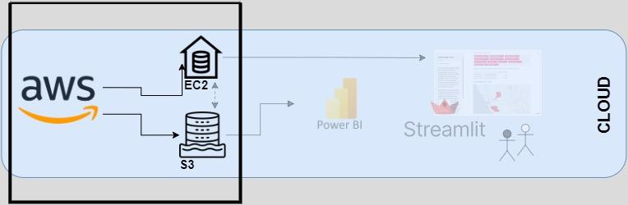
IMPLEMENTED DATA STRUCTURE (DW, DL)

Slide 9
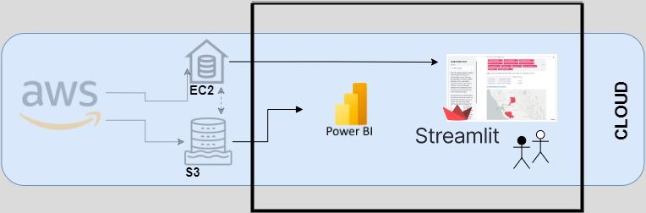
DW AUTOMATION SOLUTION

Slide 10
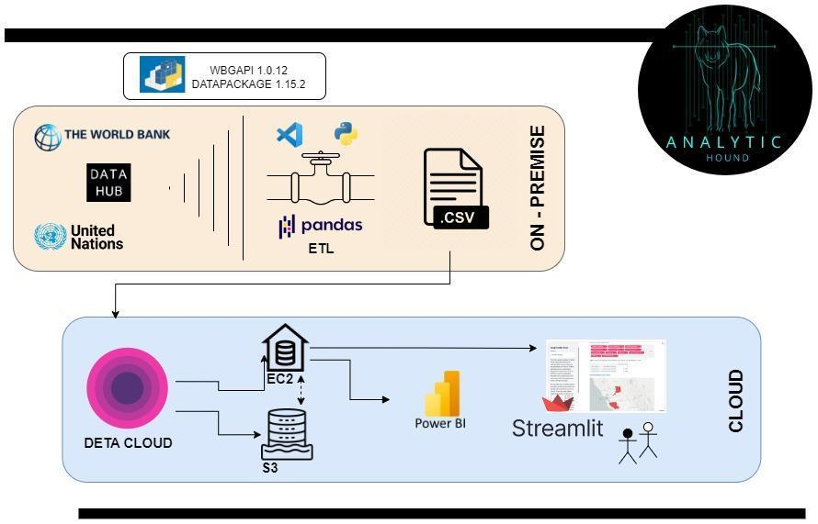
ALTERNATIVE WORKFLOW STRUCTURE

Slide 11
THANK YOU.
Are there any questions?

